Slide 1


ECE 480 Team 4
Team Members
Scott Friedman
Nate Hyde
Adi Mathew
Peter Ossian
Yongjiao Yu
Facilitator
Dr. Robert McGough
Project Liaison
Stephen Blosser
Branden’s Detented Joystick
Sponsored by:
Resource Center for Persons with Disabilities (RCPD)

Slide 2
AGENDA
Introduction by Nate
Current Joystick Design by Adi
Design Specifications by Yongjiao
Ideal Design Solution by Pete
Project Management by Scott
Summary by Nate
Notes:
Introduction / Background – Nate (~5min)
Current Design – Adi (~5min)
Design Specifications - Yongjiao (~4min)
Ideal Design Solution – Peter (~5min)
Project Management – Scott (~4min)
Conclusion / Summary – Nate (~2min)

Slide 3
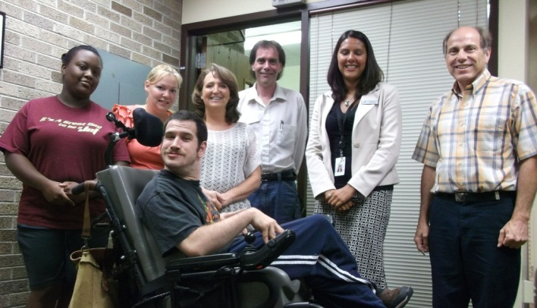
Cerebral Palsy (CP)
Disorders affecting brain
and nervous system function
Symptoms
  Abnormal muscle contractions
  Loss of coordination
  Partial paralysis
  Loss of speech

Slide 4
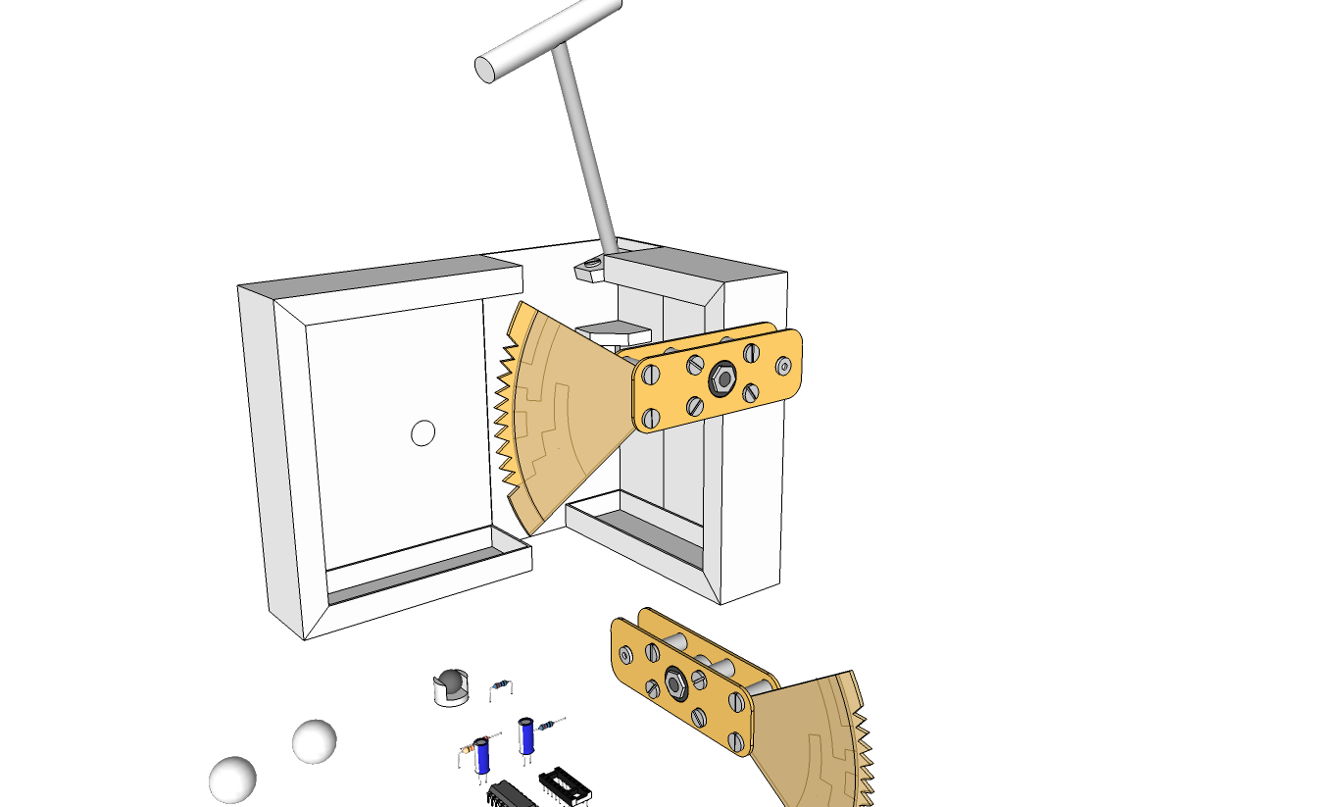
Current Joystick Design
Detents : Why ?
How ?

Slide 5
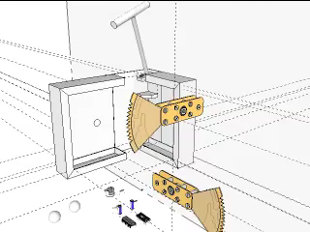
Current Joystick Design
Position sensing using Gray Code

Slide 6
Design Specifications
DELIVERABLES:
Adjustable number of detents
Adjustable detent force
USB output & connectivity
Notes:
10%
USB: user interface
-programmable detents
-programmable detent force
Computer Flexibility
-mac/pc
-Joystick position

Slide 7
Ideal Design Solution
  Hardware Design
    Two Actuators
    -position sensing
    Load Sensor
Notes:
In creating the ideal design solution the team first had to look at the design criteria and the sponsor's specifications. Joysticks for individuals with cerebral palsy experience forces several magnitudes greater than the forces given to gaming joysticks. The force namely will be seen in two key locations: the handle and, congruently with Brandon's usage, at the base.
The second concept in creating our proposed solution, like previous controllers used by Brandon, is for the joystick to detent and not return to center after the release of the handle.
While our sponsor's specifications, as stated by Yongjiao, recapped are the conversion of the joystick to an electromechanical system with software controlled parameters for matrix size and detent force feedback (NEEDS TO BE MODIFIED BASED ON YONGJIAO'S TERMINOLOGY/LANGUAGE OF SPECIFIC POINTS).

Slide 8
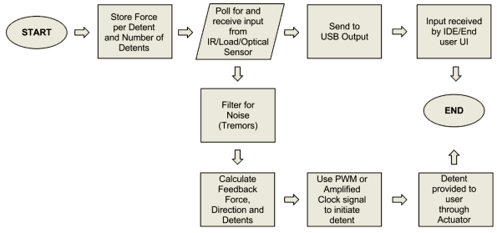
Ideal Design Solution
  Software Design
Notes:
In creating the ideal design solution the team first had to look at the design criteria and the sponsor's specifications. Joysticks for individuals with cerebral palsy experience forces several magnitudes greater than the forces given to gaming joysticks. The force namely will be seen in two key locations: the handle and, congruently with Brandon's usage, at the base.
The second concept in creating our proposed solution, like previous controllers used by Brandon, is for the joystick to detent and not return to center after the release of the handle.
While our sponsor's specifications, as stated by Yongjiao, recapped are the conversion of the joystick to an electromechanical system with software controlled parameters for matrix size and detent force feedback (NEEDS TO BE MODIFIED BASED ON YONGJIAO'S TERMINOLOGY/LANGUAGE OF SPECIFIC POINTS).
From here the team's solution includes replacing electromechanical components. Instead of the rotational teeth cog system, two linear actuators will be installed for measuring distance in the X and Y positions. In exchange with the gray code system developed in the current design, a microprocessor will handle the output as well as feedback and user programmable values.
The team will create software that will provide similar usability when compared to the previous joystick, while introducing greater range of control for the Brandon and his caretakers.
Diving into the technical operation of the joystick, software will introduce a backbone for control of the hardware. Firstly, the software will provide input variables that will hold data for the feedback as well as for the matrix array.

Slide 9
Project Development
Research State of the Art
Concept Creation
Prototype Development
Product Testing
Phase 1
Phase 2
Phase 3
Phase 4
Concept to Production Timeline

Slide 10
Budget Justification

Slide 11
SUMMARY
Branden’s story - CP individuals
Current joystick model
Design specifications
Our Design:
  Dual actuator movement
  Arduino microcontroller
  USB compatibility
Personnel, timeline & budget

Slide 12
THANK YOU!
QUESTIONS？

Slide 13
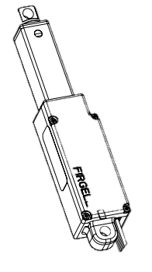
Design
Specifications
Ideal Actuator Specifications:
Max Load: 40 N
  Position precision: 0.01mm
  Minimum 40 mm/s of no-Load speed
Duty Cycle of 20%
Notes:
How often is the actuators operating. 20mins/hr
Strokes/min

Slide 14
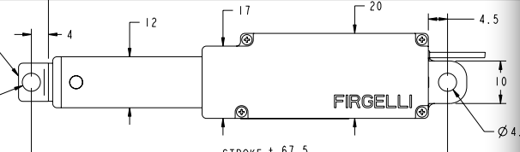
Design
Specifications
Ideal Actuator Specifications:
Packaging
  Vertically mounted
  Maximum 8 in of extended size
  50mm length of travel stroke

